Slide 1

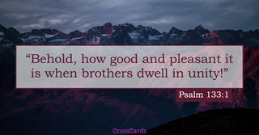
Leadership Training
Unity for Growth & Harmony
October 25, 2025

Slide 2
Leadership Training On Unity
Agenda
  Opening Prayer
    Breakfast
  Pastoral Moments
  Introduction
  Tips to Improve Unity
  Behaviors that Hinder Unity
  Ministry Leadership Administration Basics
  Conclusion
  Closing Prayer

Slide 3
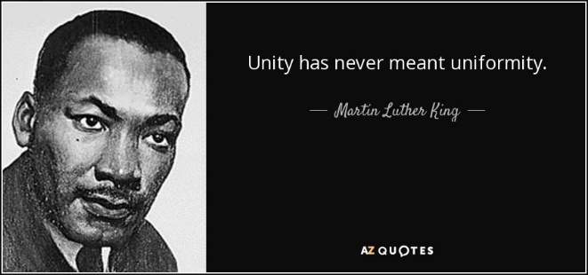
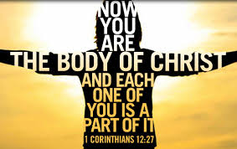
Leadership Training On Unity - Introduction
Reflect on the Sanctuary AC Problem
  Through our faith in God and our unified efforts, we prayed, we planned, and we paid.
  Lessons Learned #1

Slide 4
Leadership Training On Unity - Introduction
Reflect on the Sanctuary AC Problem
  Through our faith in God and our unified efforts,
  we prayed, we planned, and we paid.
  Lessons Learned #2
  Unity is Intentional
  Ephesians 4:3 – Make every effort to keep the unity of the Spirit through the bond of peace (CSB/NIV/NLT)
    Endeavoring (KJV)
    Eager to maintain (ESV)
    Being diligent (NASB)
  Unity doesn’t happen by chance, we must make thoughtful, deliberate actions to pursue and maintain unity.

Slide 5
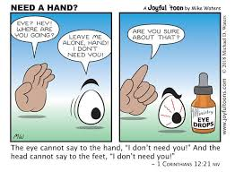
Leadership Training On Unity - Introduction
Reflect on the Sanctuary AC Problem
  Through our faith in God and our unified efforts, we prayed, we planned, and we paid.
  Lessons Learned #3
  Biblical reasons to pursue Unity
  We need each other (1 Cor 12:21)

Slide 6
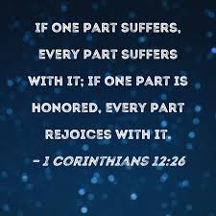
Leadership Training On Unity - Introduction
Reflect on the Sanctuary AC Problem
  Through our faith in God and our unified efforts, we prayed, we planned, and we paid.
  Lessons Learned #3
  Biblical reasons to pursue Unity
  We need each other (1 Cor 12:26)

Slide 7
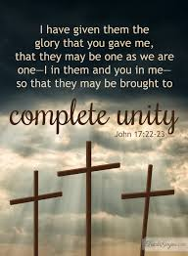
Leadership Training On Unity - Introduction
Reflect on the Sanctuary AC Problem
  Through our faith in God and our unified efforts, we prayed, we planned, and we paid.
  Lessons Learned #3
  Biblical reasons to pursue Unity
  So the world will see God’s Love (John 17:20-23)

Slide 8
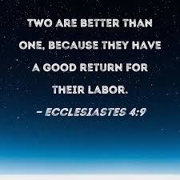
Leadership Training On Unity - Introduction
Reflect on the Sanctuary AC Problem
  Through our faith in God and our unified efforts, we prayed, we planned, and we paid.
  Lessons Learned #3
  Biblical reasons to pursue Unity
  We can do more together (Ecclesiastes 4:9)

Slide 9
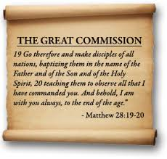
Leadership Training On Unity - Introduction
Reflect on the Sanctuary AC Problem
  Through our faith in God and our unified efforts, we prayed, we planned, and we paid.
  Unity requires a common goal
  What is the common goal that unifies the church?
  Always keep this common goal that unifies us in the forefront of your mind as leaders.

Slide 10



Leadership Training On Unity – Tips to Improve Unity
Honor your leader’s position (1 Thessalonians 5:12)
  We must learn to be good followers, before we can be good leaders.
  Support your leader, Pray for them and avoid speaking disrespectfully
  This does not mean always agreeing with your leader.

Slide 11

Leadership Training On Unity – Tips to Improve Unity
Respect your team’s time (Philippians 2:3-4)
  Good meetings establish a culture that enhances unity, but meetings must:
    Start on time
    Have an agenda
    Be productive
    End on time

Slide 12
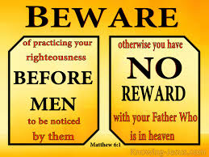
Leadership Training On Unity – Tips to Improve Unity
Kingdom Motives (Matthew 6:1)
  Your only motivation to lead your ministry should be to support the common goal of the church
  Any other motive is easily observed and can disrupt unity

Slide 13
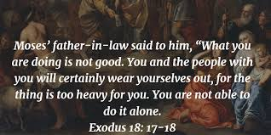
Leadership Training On Unity – Tips to Improve Unity
Relieve your leader of tasks (Exodus 18:17-18)
  When you see something that needs to be done, volunteer to do it.
  Sometimes asking your leader for something to do actually gives your leader another task.
  Be willing to do what no one else is doing.
  Don’t just identify problems to your leader, but offer solutions.

Slide 14
Leadership Training On Unity – Behaviors That Hinder Unity
Lead up well, but lead down poorly
  Take credit, but cast blame.
  Condescending or degrading towards team members.
  Remember Honor is given, but respect is earned.

Slide 15

Leadership Training On Unity – Behaviors That Hinder Unity
Caring about people but tolerating underperformance.
  Yes we are a church and we are to care for each other, but tolerating underperformance hinders unity.
  Lowers the bar for everyone else on the team.
  Whatever you allow, you will get more of.
  Frustrates other team members.
  Full of Grace and Truth (John 1:14)

Slide 16
Leadership Training On Unity – Behaviors That Hinder Unity
Caring about people but tolerating underperformance.
  Yes we are a church and we are to care for each other, but tolerating underperformance hinders unity
  Lowers the bar for everyone else on the team
  Whatever you allow, you will get more of
  Frustrates other team members
  Full of Grace and Truth (John 1:14)

Slide 17
Leadership Training On Unity – Behaviors That Hinder Unity
Too much control, limits growth
  Leaders who keep too much control, suppress future leaders in your team.
  If everything depends on one leader, growth is impeded.
  Learn to delegate authority, not just tasks.
  Embrace different ways to accomplish goals.

Slide 18
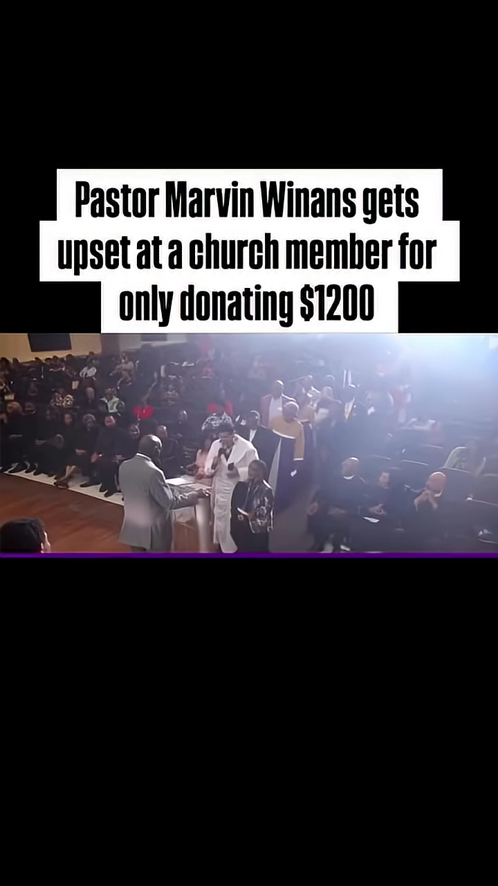

Leadership Training On Unity – Behaviors That Hinder Unity
Hit the Goals, but hurt the team

Slide 19
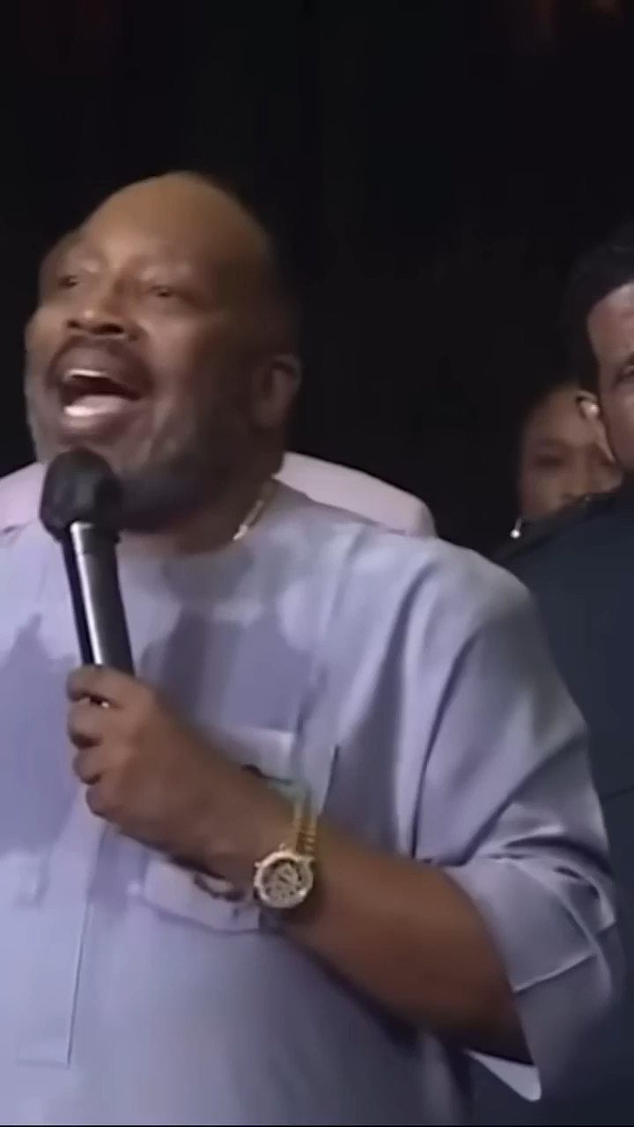
Leadership Training On Unity – Behaviors That Hinder Unity
Hit the Goals, but hurt the team

Slide 20
Leadership Training On Unity – Administrative Basics
Meetings
  Take Minutes/Notes
  Assign Actions with Due Dates
  Follow-up with team members before next meeting.
Council Meeting Reports
  Look ahead for 6 months for ministry events
  Request Pastor’s approval for speakers

Slide 21
Leadership Training On Unity – Conclusion / Summary
Unity requires a common goal and our common goal is the Great Commission
Tips to Improve Unity
Behaviors that hinder Unity
Ministry Leadership Administrative Basics
CLOSING PRAYER

